Slide 1
Authenticating On-Body Backscatter by Exploiting Propagation Signatures
Zhiqing Luo¹, Wei Wang¹, Jiang Xiao¹,
Qianyi Huang², Tao Jiang¹, Qian Zhang²
¹Huazhong University of Science and Technology
²Hong Kong University of Science and Technology
Notes:
Good afternoon everyone. My name is Zhiqing Luo and I am from Hust. It is my great honor to present our work here today. The title of our paper is

Slide 2
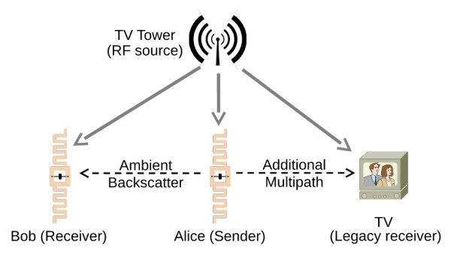
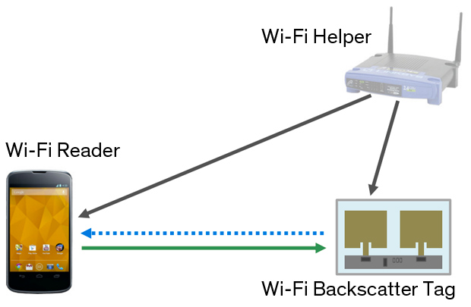
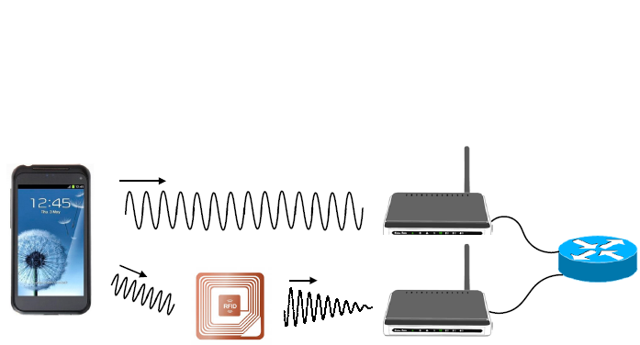
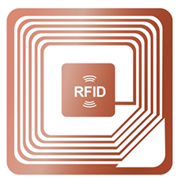
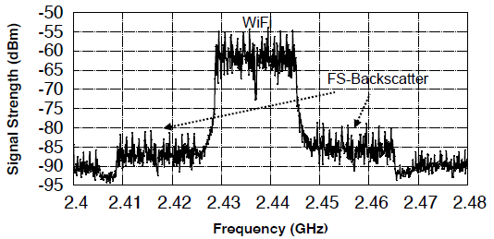
Backscatter Communication Technologies
Ambient backscatter
WiFi backscatter
FS backscatter
HitchHike
Notes:
First, we will start from a simple introduction of backscatter communication. Backscatter communication, this low-power technology, origins from RFID technologies. However, different from RFID the advantage of backscatter is that it is not need a dedicate and expensive Reader. It transmits data by reflecting the ambient signals, such as the signals from a TV tower, access point or a cell phone.

Slide 3

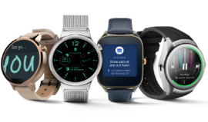
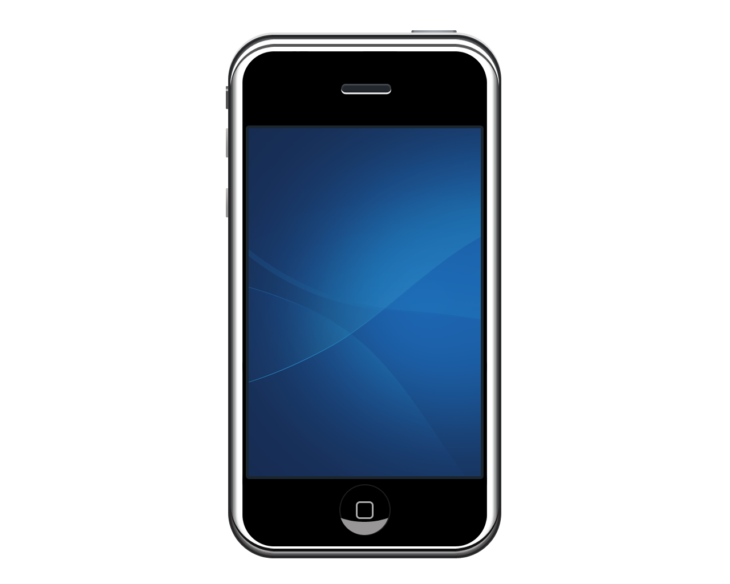

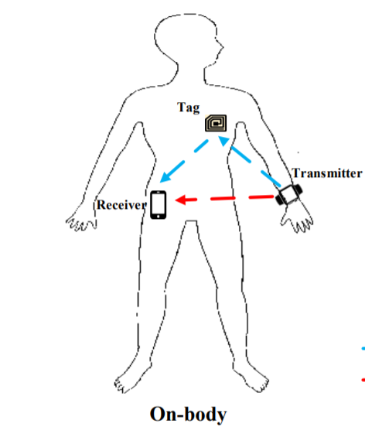

Backscatter for On-body Devices
Smart Watch
Smartphone
Low-power backscatter can be used to transmit data by reflecting on-body signals
Commercial on-body devices
Backscatter communications
On-body backscatter
Backscatter for healthcare
Notes:
As the development of backscatter communication, backscatter has been successfully used to reflect WiFi, BLE and Zigbee protocol. On the other hand, most of on-body devices , such as smart watch, mobile phone are using these protocols , which makes it possible for backscatter to transmit data by reflecting the signals of the on-body devices. For example, we can use backscatter tag as the implanted devices to transmit the data of our health.

Slide 4


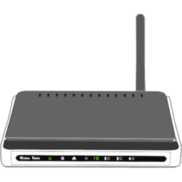
Security Problem of On-body Backscatter
Active attacker
Constant power attacker: launch power to imitate the on-body tag
Powerful attacker: transmit varying powers to imitate the tag
Tag attacker
The same scheme as on-body tag
Whether the received signals are from my tag?
Notes:
Previous works have focused on the communication dimension, while the security dimension remains vulnerable. It has been demonstrated that wireless connectivity can be exploited to send unauthorized commands or fake messages that result in device malfunctioning. For example, an active attacker can imitate the on-body tag by transmitting constant or varying intermittently. On the other hand, an attacker can use a tag that has the same construction as the on-body tag to spoofing the receiver. Therefore, the receiver should authenticate whether

Slide 5


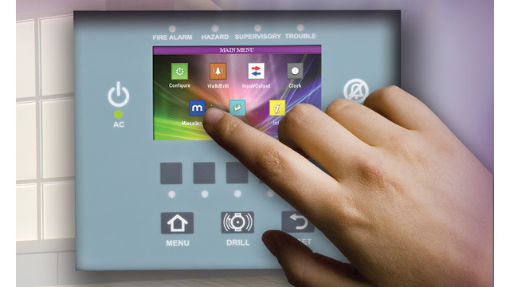
Limitations of Traditional Methods
Limited by power and hardware
Touch and gesture
Complex encryption
Password input
Can we authenticate the on-body tag without large power consumption and hardware change?
Notes:
Traditional methods to solve such authentication problems may rely on Complex encryption , touch or gesture recognition and password, However, because of the simple design , backscatter tag cannot support these methods. So we want to ask, Can we authenticate the on-body tag without large power consumption and hardware change?

Slide 6
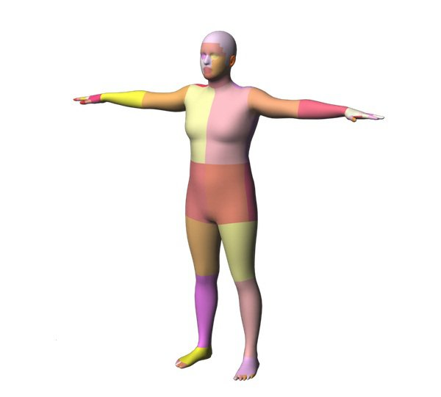
On-body Radio Propagation
On-body propagation is dominated by creeping waves
Easily affected by body surface movement
Easily affected by on-body device antenna movement
Notes:
In this paper, we consider using the on-body propagation signatures to authenticate the on-body tag. As show in this picture, previous works have proof the electromagnetic (EM) waves mainly propagate around the human body surface via diffraction. On-body propagation is dominated by creeping waves. As a result, these on-body radios Easily affected by body surface movement, and on-body device antenna movement.

Slide 7
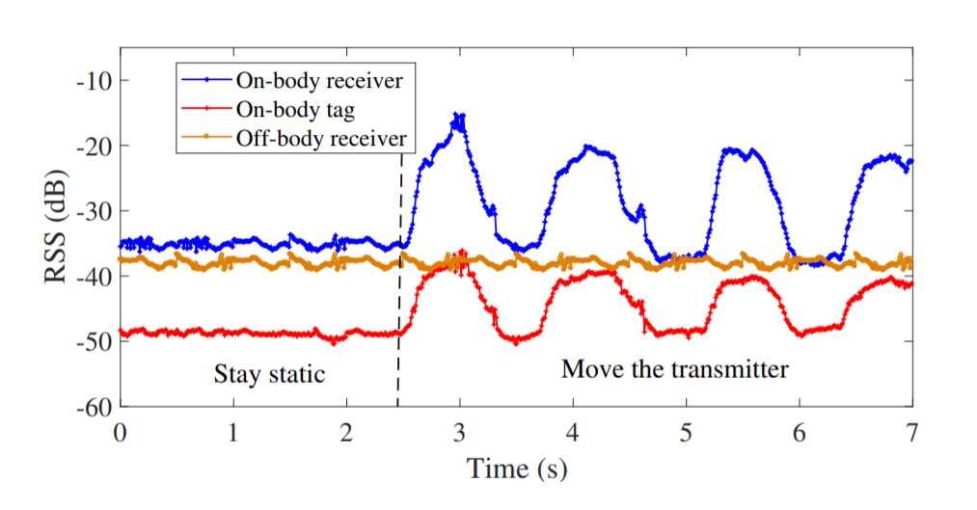
Our Observation
On-body receiver
Off-body receiver
On-body receiver and on-body tag propagation are affected by transmitter movement
On-body tag
Notes:
To verify this observation, we conduct an experiment. In particular, we
First, we keep the human body stay static.
Then, we move the antenna of the transmitter back and forth for several periods.
Finally, we plot the received signal strength of the on-body receiver.

Slide 8
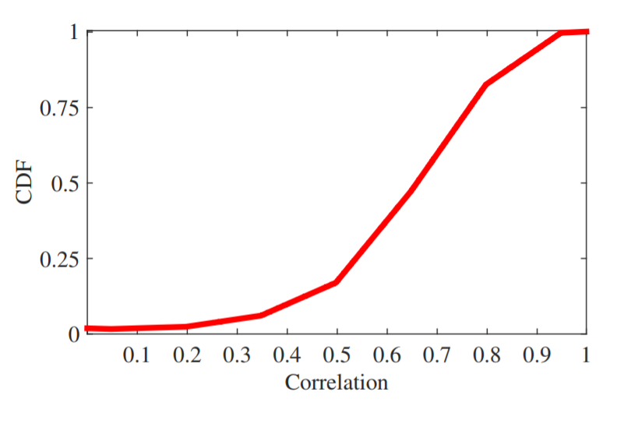
Idea: Authenticate by Radio Propagation
Move the on-body transmitter
Authenticate by detecting and matching the RSS changes of backscatter signal and source signal
Notes:
Thus, the idea of our paper is to

Slide 9
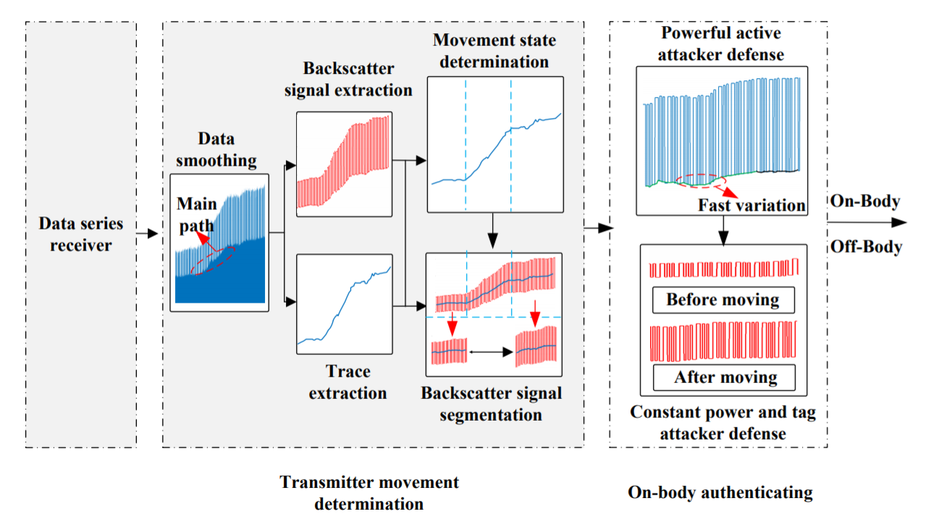
An Overview of Our System
Data collection
Movement determination
On-body authenticating
Notes:
Here, is an overview of our system. Which contains three key parts. First , we collect and make some pre-process of the raw data from the on-body receiver; second, we extract the RSS trace of the source signal from transmitter to receiver to determine the variation states of transmitter movement. Besides, we will decode the backscatter signals of tag from the raw data, and then segment the backscatter signals by matching the RSS trace.; finally, we authenticate the on-body tag by comparing the RSS variations of these segments.
Now, we will demonstrate each step of our system.

Slide 10
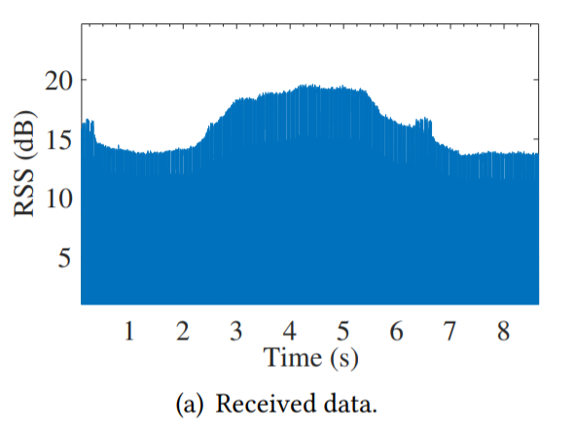
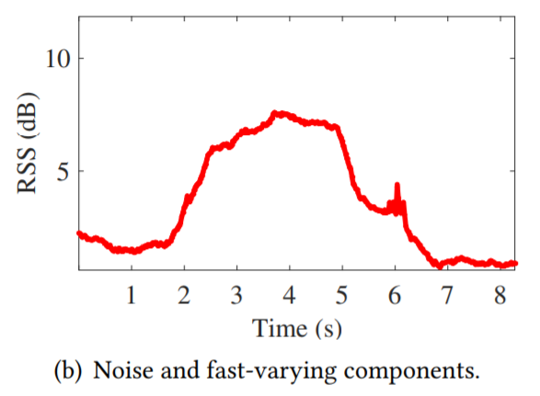
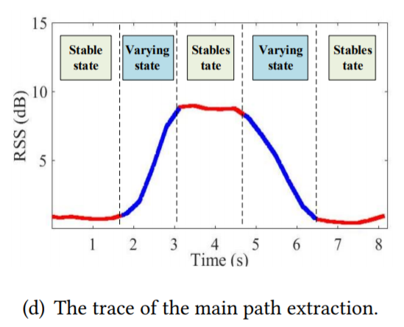
Trace Extraction
Raw data
Noise existing
Variation state
Receive the raw data from on-body receiver
Extract the source signal trace
Smooth the trace
Calculate the slope to determine the variation states
Notes:
First of all,

Slide 11
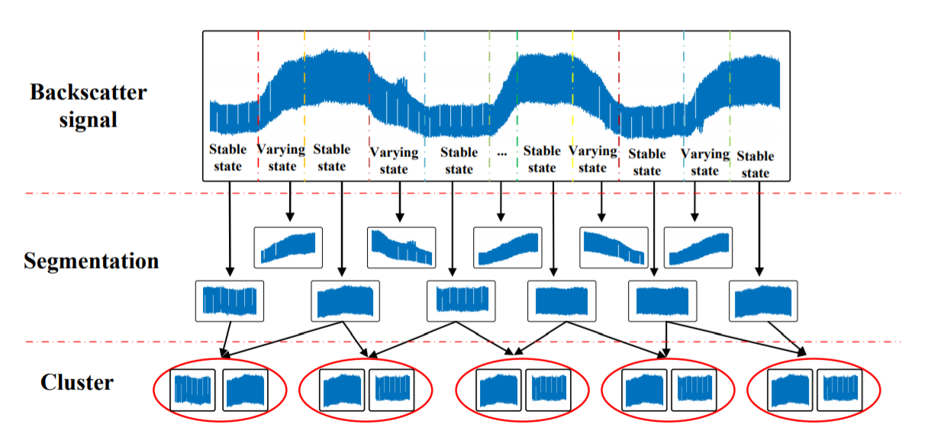
Backscatter Signal Segmentation

Slide 12
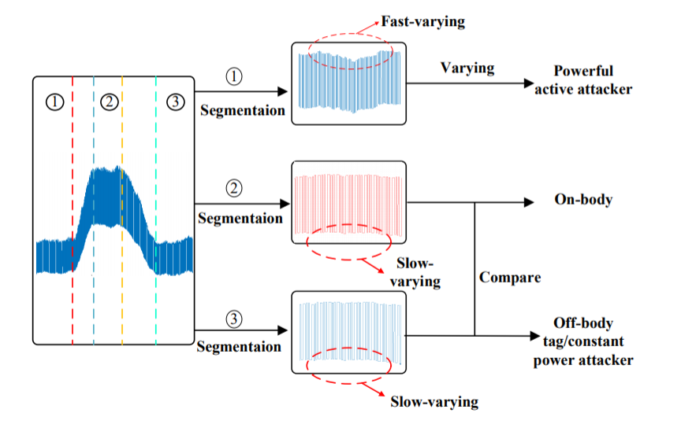
On-body Authentication
If the backscatter signals vary fast, they should be from an active attacker
If the backscatter signals vary slow, we compare the segments in each cluster

Slide 13
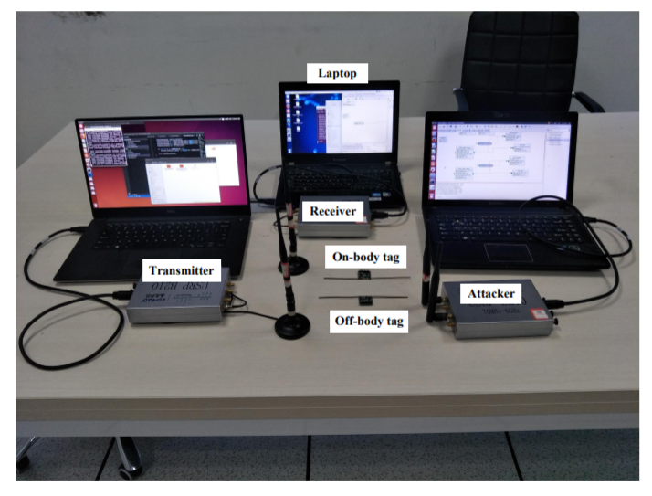
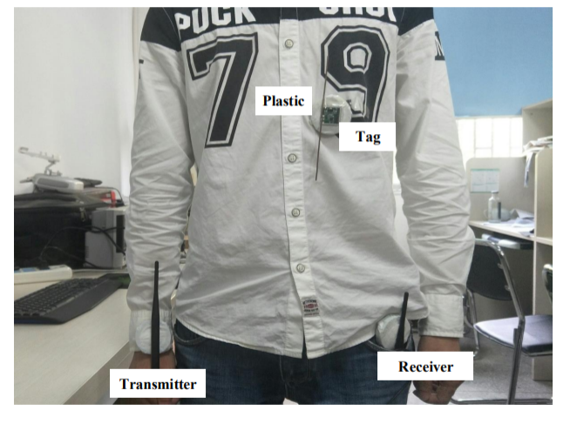
Implementation
Implemented on GNUradio/USRP platform.
Place the antennas of them on the body and they operate at 900 MHz or 2.4GHz.
Evaluated at static and dynamic environments.

Slide 14
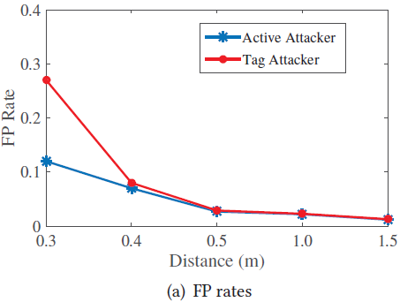
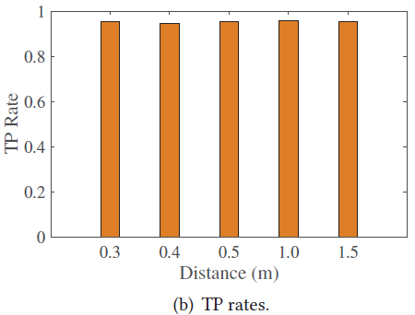
Evaluation –Static Environment
We keep the human body stay static
Place the active attacker at different distances from body

Slide 15
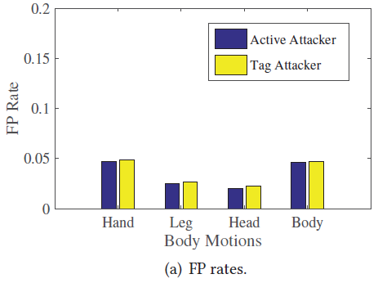
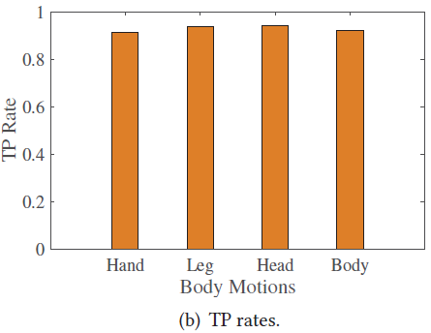
Evaluation –Dynamic Environment
We keep the human body do some motions
We ask two people to walk around

Slide 16
Conclusion
We show that on-body propagation signatures can be leveraged to authenticate on-body tag;
We develop SecureScatter, an on-body backscatter authentication framework that requires no extra process or hardware at the backscatter tag;
We test SecureScatter under different static and dynamic environments to defend against active and tag attackers.

Slide 17
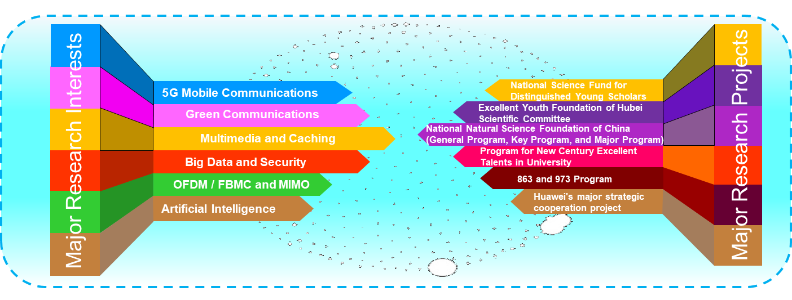
Research Interests
Major Research Interests
Major Research Projects
5
G Mobile Communications
National Science Fund for Distinguished Young Scholars
Green Communications
Excellent Youth Foundation of Hubei Scientific Committee
Multimedia and Caching
National Natural Science Foundation of China (General Program, Key Program, and Major Program)
Big Data and Security
Program for New Century Excellent Talents in University
OFDM / FBMC and MIMO
863 and 973 Program
Artificial Intelligence
Huawei's major strategic cooperation project

Slide 18
Thank you!
Notes:
Thank you

